Slide 1
Chapter 21 Sets and Maps

Slide 2
Objectives
To store unordered, nonduplicate elements using a set (§21.2).
To explore how and when to use HashSet (§21.2.1), LinkedHashSet (§21.2.2), or TreeSet (§21.2.3) to store elements.
To compare performance of sets and lists (§21.3).
To use sets to develop a program that counts the keywords in a Java source file (§21.4).
To tell the differences between Collection and Map and describe when and how to use HashMap, LinkedHashMap, and TreeMap to store values associated with keys (§21.5).
To use maps to develop a program that counts the occurrence of the words in a text (§21.6).
To obtain singleton sets, lists, and maps, and unmodifiable sets, lists, and maps, using the static methods in the Collections class (§21.7).

Slide 3
Motivations
The “No-Fly” list is a list, created and maintained by the U.S. government’s Terrorist Screening Center, of people who are not permitted to board a commercial aircraft for travel in or out of the United States. Suppose we need to write a program that checks whether a person is on the No-Fly list. You can use a list to store names in the No-Fly list. However, a more efficient data structure for this application is a set.
Suppose your program also needs to store detailed information about terrorists in the No-Fly list. The detailed information such as gender, height, weight, and nationality can be retrieved using the name as the key. A map is an efficient data structure for such a task.

Slide 4
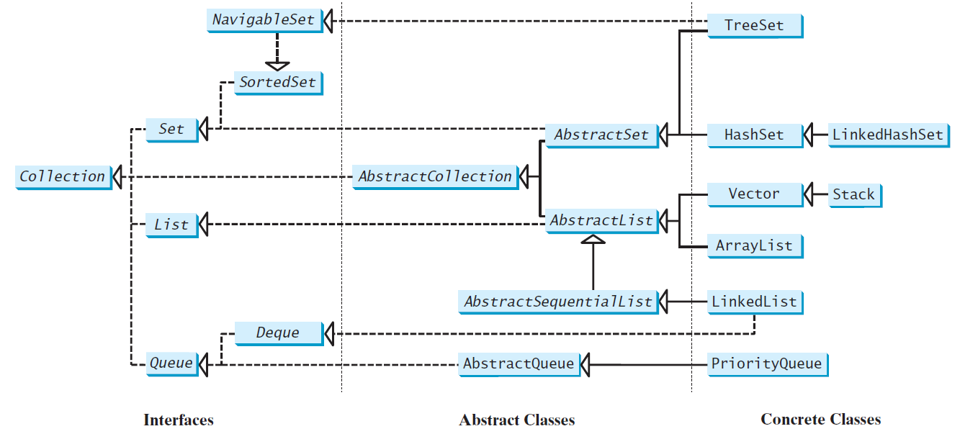
Review of Java Collection Framework hierarchy
Set and List are subinterfaces of Collection.

Slide 5
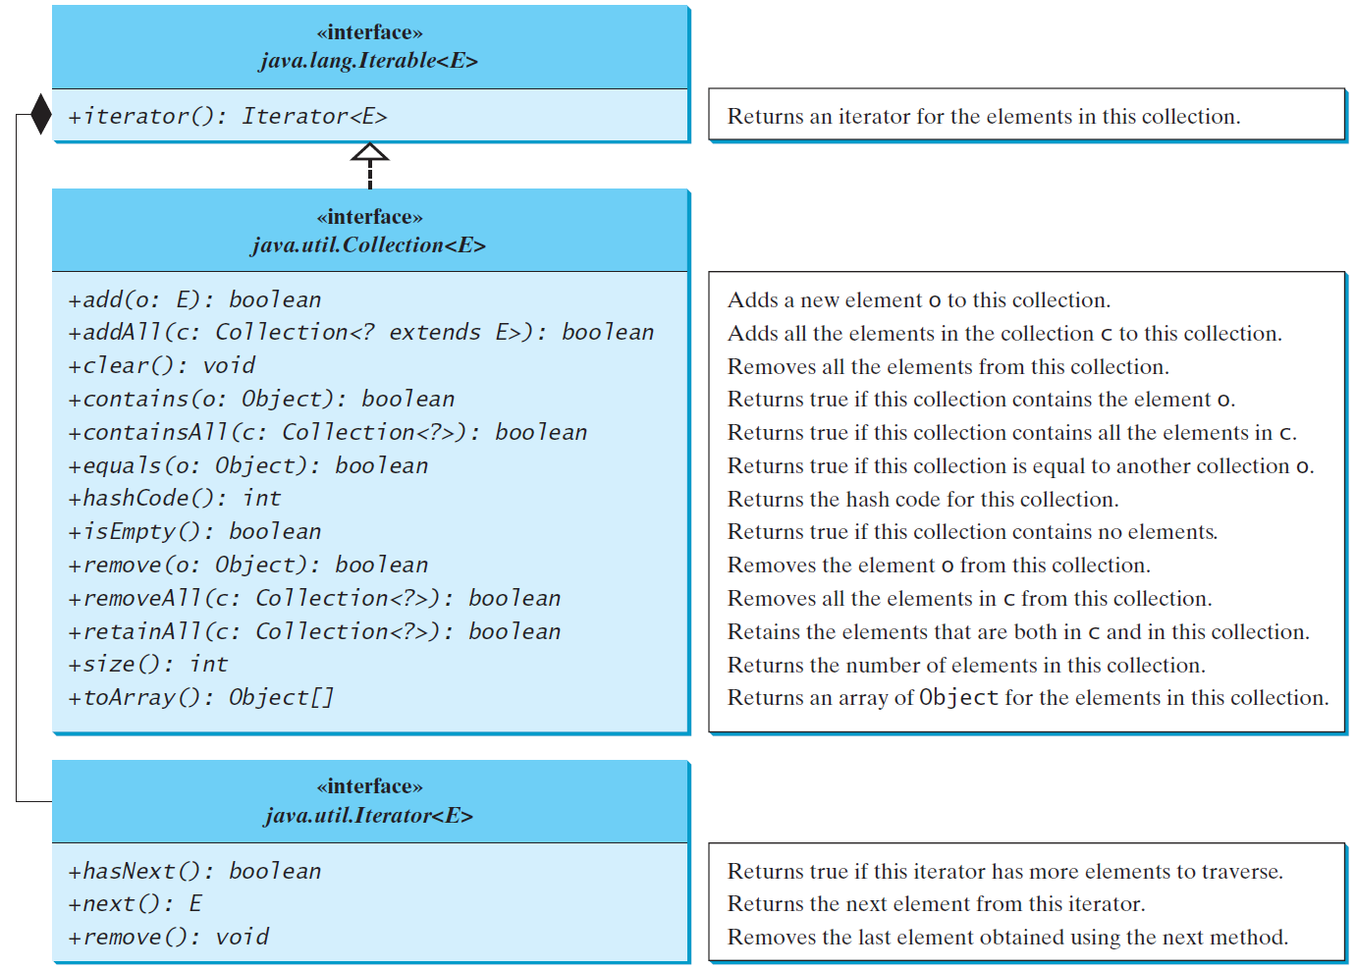
Collection Interface
The Collection interface is the root interface for manipulating a collection of objects.

Slide 6
The Set Interface
The Set interface extends the Collection interface.
It does not introduce new methods or constants, but it stipulates that an instance of Set contains no duplicate elements.
The concrete classes that implement Set must ensure that no duplicate elements can be added to the set. Thus, no two elements e1 and e2 can be in the set where e1.equals(e2) is true.
One major purpose for using a set is to determine if a specific object is in that set. (Like if a passenger is in the “No-Fly” list.)

Slide 7
The Set Interface
Java has three basic Set implementations: HashSet, TreeSet, and LinkedHashSet.
HashSet:
  Stores its elements in a hash table
  Most efficient of the three
  But it does not control the order of the objects
TreeSet:
  Stores its elements in an underlying sorted tree structure
  Orders its elements based on their values
  Much slower than HashSet.
LinkedHashSet:
  Structured as an underlying hash table with a linked list running through it
  Orders its elements based on the order in which they were inserted into the set
  Provides some order to the set with just a little more work than HashSet

Slide 8
Set Operations
Description
boolean add (E e): Adds element e to the set, if it’s not already there
boolean addAll(Collection<? Extends E> c: adds all the elements in collection c to the set if they are not already there
void clear(): removes all elements from the set
boolean contains(Object o): returns true if o is in the set
boolean containsAll(Collection <?> c): returns true if the set contains all of the elements in c
boolean equals(Object o): returns true if this set is equal to o
int hashcode(): returns the hashcode value for this set
boolean isEmpty(): returns true if the set is empty
Iterator iterator(): returns an iterator object that can be used to traverse this set CANNOT USE LISTITERATOR.
boolean remove(Object o): removes object, o, from the set if it is there
boolean removeAll(Collection <?> c): removes all of the objects that are in c from this set
boolean retainAll(Collection <?> c): retain only the elements that are in c
int size(): returns the number of elements in the set
Object[ ] toArray(): returns an array with all of the elements in this set

Slide 9
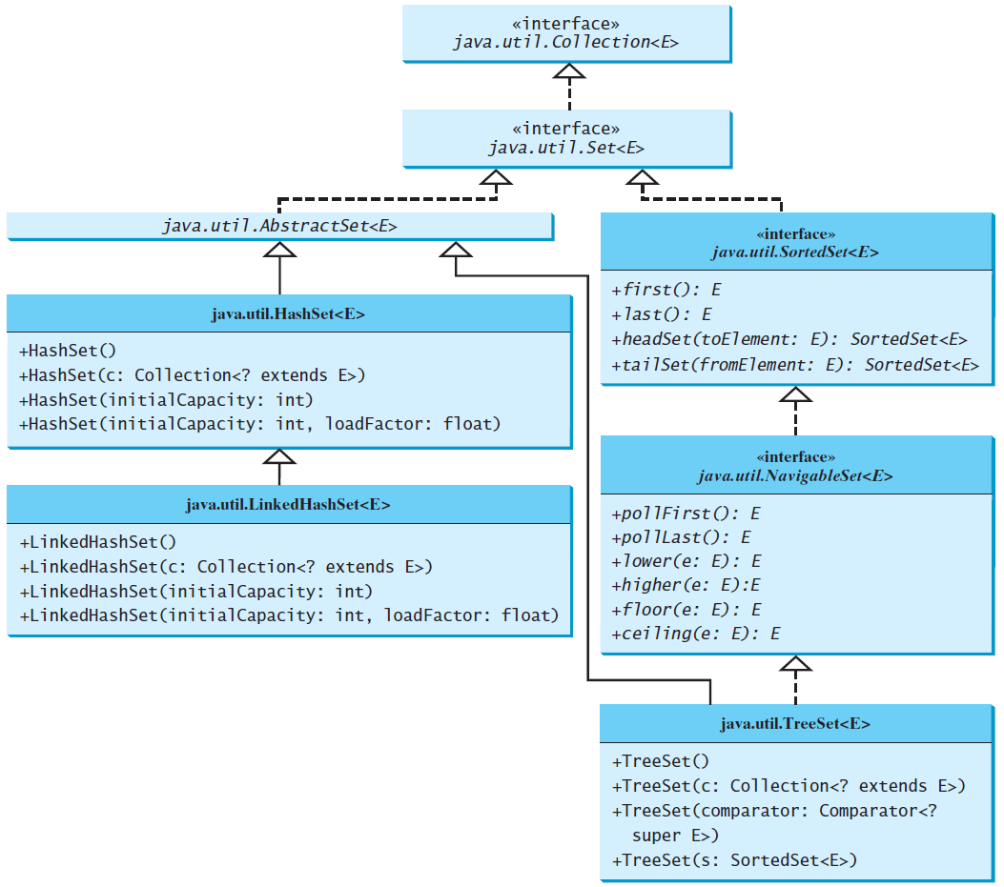
The Set Interface Hierarchy

Slide 10
The AbstractSet Class
The AbstractSet class is a convenience class that extends AbstractCollection and implements Set.
The AbstractSet class provides concrete implementations for the equals method and the hashCode method.
The hash code of a set is the sum of the hash code of all the elements in the set.
Since the size method and iterator method are not implemented in the AbstractSet class, AbstractSet is an abstract class.

Slide 11
The HashSet Class
The HashSet class is a concrete class that implements Set.
It can be used to store duplicate-free elements.
For efficiency, objects added to a hash set need to implement the hashCode method in a manner that properly disperses the hash code.

Slide 12
Implementing Sets and Maps
The HashSet and HashMap classes are implemented using a process called hashing
The elements in them are stored in an underlying hash table with indexes
An element’s index in a hash table is calculated using a hash function
A hash function takes the element itself and performs some type of calculation on it, resulting in an integer. That integer is used as an index for the element’s position in the hash table.
More than one element may be stored in the same location (this is called a collision)
A hashing function that calculates a unique index for each element is called a perfect hashing function

Slide 13
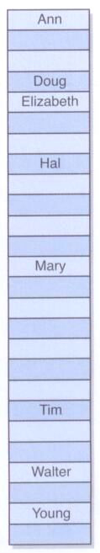
Hashing
A hash table with a basic hash function that is based on the first letter of each name:
If you have collisions, then Java determines a way to store multiple items at that location. (Often using a linked list.)
13

Slide 14
Example: Using HashSet
This example creates a hash set filled with strings and uses different HashSet methods on it
Another Example
// Create a HashSet object called countries
HashSet<String> countries = new HashSet<String>();
countries.add("Uruguay");
countries.add("Poland");
countries.add("Singapore");
countries.add("Indonesia");
countries.add("Austria");
// print the HashSet using the built-in toString
// method
System.out.println(countries);
// remove an element from the set
countries.remove("Poland");
// check if a country is in the list
if (countries.contains("Poland"))
System.out.println("Poland is in the set");
else
System.out.println("Poland is not in the set");
// loop through the HashSet
for (String c: countries)
System.out.print(c + " ");
System.out.println();
//clear the HashSet
countries.clear();

Slide 15
Example: Using LinkedHashSet
import java.util.*;
public class TestLinkedHashSet {
public static void main(String[] args) {
// Create a linked hash set
Set<String> set = new LinkedHashSet<>();
// Add strings to the set
set.add("London");
set.add("Paris");
set.add("New York");
set.add("San Francisco");
set.add("Beijing");
set.add("New York");
System.out.println(set);
// Display the elements in the hash set
for (String element: set)
System.out.print(element.toLowerCase() + " ");
}
}
This example creates a linked hash set filled with strings and uses an enhanced for loop to traverse the elements in the list.
TestLinkedHashSet

Slide 16
The SortedSet Interface and the TreeSet Class
SortedSet is a subinterface of Set, which guarantees that the elements in the set are sorted.
TreeSet is a concrete class that implements the SortedSet interface.
You can use an iterator to traverse the elements in the sorted order.
The elements can be sorted in two ways.

Slide 17
The SortedSet Interface and the TreeSet Class, cont.
One way is to use the Comparable interface.
The other way is to specify a comparator for the elements in the set if the class for the elements does not implement the Comparable interface, or you don’t want to use the compareTo method in the class that implements the Comparable interface.
This approach is referred to as order by comparator.

Slide 18
Some TreeSet Operations
Description
E first() Returns the first (lowest) element currently in this set.
E last() Returns the last (highest) element currently in this set.
E ceiling(E e) Returns the least element in this set greater than or equal to the given element, or null if there is no such element.
E floor(E e) Returns the greatest element in this set less than or equal to the given element, or null if there is no such element.
SortedSet<E> headSet(E toElement) Returns a view of the portion of this set whose elements are strictly less than toElement.
SortedSet<E> tailSet(E fromElement) Returns a view of the portion of this set whose elements are greater than or equal to fromElement.
E lower(E e) Returns the greatest element in this set strictly less than the given element, or null if there is no such element.
E higher(E e) Returns the least element in this set strictly greater than the given element, or null if there is no such element.
E pollFirst() Retrieves and removes the first (lowest) element or returns null if this set is empty.
E pollLast() Retrieves and removes the last (highest) element or returns null if this set is empty.

Slide 19
Example: Using TreeSet to Sort Elements in a Set
The example on the next page creates a hash set filled with strings, and then creates a tree set for the same strings.
The strings are sorted in the tree set using the compareTo method in the Comparable interface.
The example also creates a tree set of geometric objects.
The geometric objects are sorted using the compare method in the Comparator interface.
TestTreeSet

Slide 20
Example: Using TreeSet to Sort Elements in a Set
public class TestTreeSet {
public static void main(String[] args) {
// Create a hash set
Set<String> set = new HashSet<>();
// Add strings to the set
set.add("London");
set.add("Paris");
set.add("New York");
set.add("San Francisco");
set.add("Beijing");
set.add("New York");
// Create a tree set from the hash set
TreeSet<String> treeSet = new TreeSet<>(set);
System.out.println("Sorted tree set: " + treeSet);
// Use the methods in SortedSet interface
System.out.println("first(): " + treeSet.first());
System.out.println("last(): " + treeSet.last());
System.out.println("headSet(\"New York\"): " +
treeSet.headSet("New York"));
System.out.println("tailSet(\"New York\"): " +
treeSet.tailSet("New York"));
// Use the methods in NavigableSet interface
System.out.println("lower(\"P\"): " + treeSet.lower("P"));
System.out.println("higher(\"P\"): " + treeSet.higher("P"));
System.out.println("floor(\"P\"): " + treeSet.floor("P"));
System.out.println("ceiling(\"P\"): " + treeSet.ceiling("P"));
System.out.println("pollFirst(): " + treeSet.pollFirst());
System.out.println("pollLast(): " + treeSet.pollLast());
System.out.println("New tree set: " + treeSet);
}
}

Slide 21
Example: The Using Comparator to Sort Elements in a Set
import java.util.*;
public class TestTreeSetWithComparator {
public static void main(String[] args) {
// Create a tree set for geometric objects using a comparator
Set<GeometricObject> set = new TreeSet<>(new GeometricObjectComparator());
set.add(new Rectangle(4, 5));
set.add(new Circle(40));
set.add(new Circle(40));
set.add(new Rectangle(4, 1));
// Display geometric objects in the tree set
System.out.println("A sorted set of geometric objects");
for (GeometricObject element: set)
System.out.println("area = " + element.getArea());
}
}
This program demonstrates how to sort elements in a tree set using the Comparator interface. The example creates a tree set of geometric objects. The geometric objects are sorted using the compare method in the Comparator interface.
TestTreeSetWithComparator

Slide 22
Case Study: Counting Keywords
The example on the next page presents an application that counts the number of the keywords in a Java source code file.
CountKeywords

Slide 23
Case Study: Counting Keywords
import java.util.*;
import java.io.*;
public class CountKeywords
{
public static void main(String[] args) throws Exception
{
Scanner input = new Scanner(System.in);
System.out.print("Enter a Java source file: ");
String filename = input.nextLine();
File file = new File(filename);
if (file.exists())
{
System.out.println("The number of keywords in " + filename
+ " is " + countKeywords(file));
}
else
System.out.println("File " + filename + " does not exist");
}
public static int countKeywords(File file) throws Exception {
// Array of all Java keywords + true, false and null
String[] keywordString = {"abstract", "assert", "boolean",
"break", "byte", "case", "catch", "char", "class", "const",
"continue", "default", "do", "double", "else", "enum",
"extends", "for", "final", "finally", "float", "goto",
"if", "implements", "import", "instanceof", "int",
"interface", "long", "native", "new", "package", "private",
"protected", "public", "return", "short", "static",
"strictfp", "super", "switch", "synchronized", "this",
"throw", "throws", "transient", "try", "void", "volatile",
"while", "true", "false", "null"};
Set<String> keywordSet = new HashSet<>(Arrays.asList(keywordString));
int count = 0;
Scanner input = new Scanner(file);
while (input.hasNext())
{
String word = input.next();
if (keywordSet.contains(word))
count++;
}
return count;
}
}

Slide 24
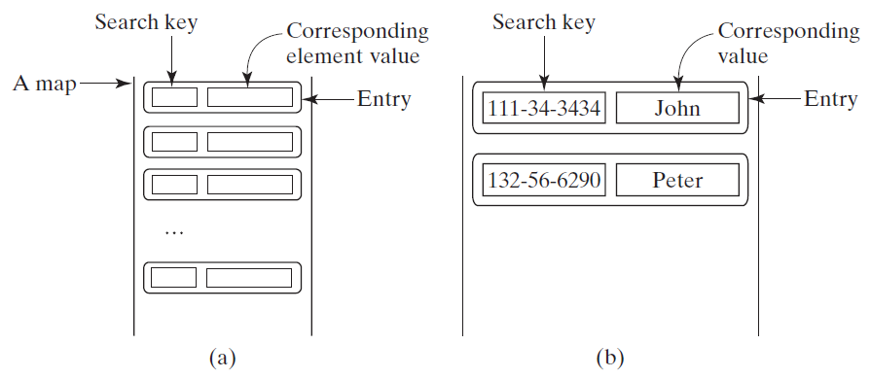
The Map Interface
The Map interface maps keys to the elements. The keys are like indexes. In List, the indexes are integer. In Map, the keys can be any objects.

Slide 25
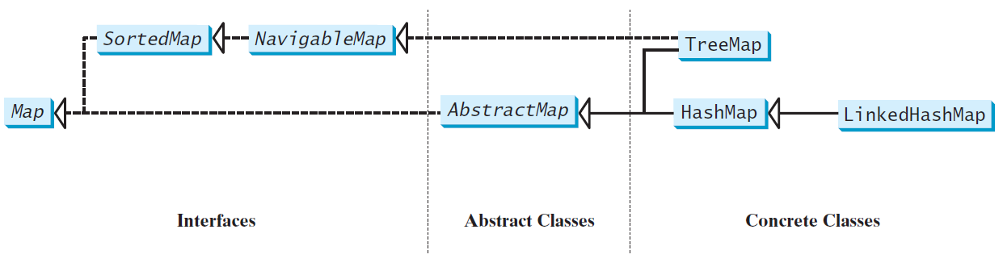
Map Interface and Class Hierarchy
An instance of Map represents a group of objects, each of which is associated with a key.
You can get the object from a map using a key, and you have to use a key to put the object into the map.
Keys must be unique, but there can be duplicate values

Slide 26
The Map Interface Methods
Description
void clear() - Removes all of the mappings from this map (optional operation).
boolean containsKey(Object key) - Returns true if this map contains a mapping for the specified key.
boolean containsValue(Object value) - Returns true if this map maps one or more keys to the specified value.
Set<Map.Entry<K,V>> entrySet() - Returns a Set view of the mappings contained in this map.
V get(Object key) - Returns the value to which the specified key is mapped, or null if this map contains no mapping for the key.
boolean isEmpty() - Returns true if this map contains no key-value mapping
Set<K> keySet() - Returns a Set view of the keys contained in this map.
V put(K key, V value) – Inserts a key and value pair into the map
void putAll(Map<? extends K,? extends V> m) - Copies all of the mappings from the specified map to this map (optional operation).
V remove(Object key) - Removes the mapping for a key from this map if it is present
int size() - Returns the number of key-value pairs in this map.
Collection<V> values() - Returns a Collection view of the values contained in this map.

Slide 27
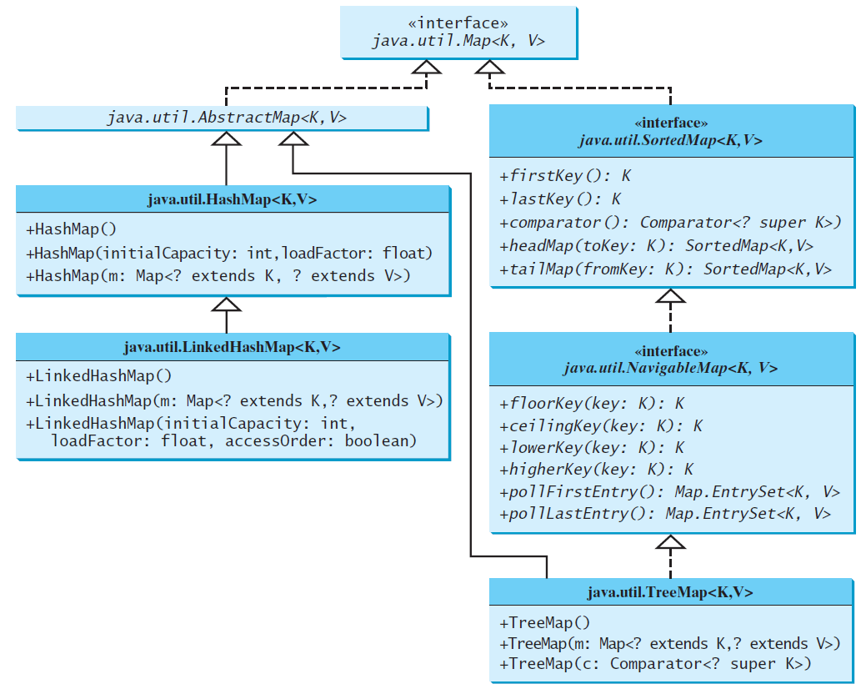
Concrete Map Classes

Slide 28
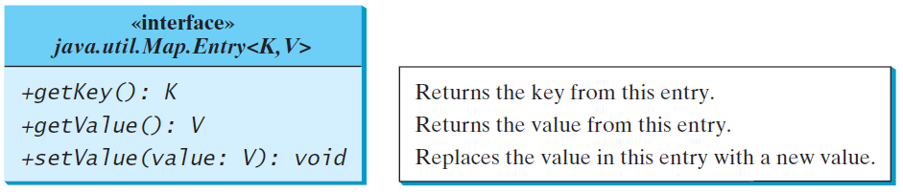
Entry

Slide 29
HashMap and TreeMap
The HashMap, LinkedHashMap, and TreeMap classes are three concrete implementations of the Map interface.
The HashMap class is efficient for locating a value, inserting a mapping, and deleting a mapping.
The keys are not stored in any particular order in a HashMap though
The TreeMap class (implementing SortedMap) lets you traverse the keys in a sorted order.
The TreeMap class requires a little more overhead by Java since it keeps the keys sorted for you.
References
Geeksforgeeks
W3Schools HashMap

Slide 30
LinkedHashMap
LinkedHashMap extends HashMap with a linked list implementation that supports an ordering of the entries in the map.
The entries in a LinkedHashMap can be retrieved in the order in which they were inserted into the map (known as the insertion order), or the order in which they were last accessed, from least recently accessed to most recently (access order).
When you create a LinkedHashMap using the no-argument constructor it will use the insertion order.
To construct a LinkedHashMap with the access order, use the LinkedHashMap(initialCapacity, loadFactor, true).
Notes:
If you put an entry that already exist, it will change that entry to a new value. (update the value)

Slide 31
HashMap Example
import java.util.HashMap;
public static void main(String[] args)
{
// Create a HashMap object called mortgages with
// customer name and mortgage amount
HashMap<String, Double> mortgages =
new HashMap<String, Double>();
// Add keys and values (Country, City)
mortgages.put("Bob", 95000.00);
mortgages.put("Jill", 150000.00);
mortgages.put("Andrew", 139000.00);
mortgages.put("Alice", 176000.00);
System.out.println(mortgages);
// get and print Jill's mortgage amount
System.out.println("Jill's Mortgage: " +
mortgages.get("Jill"));
// remove Andrew's mortgage from the map
mortgages.remove("Andrew");
// print the size of the map
System.out.println(mortgages.size());
// print all the keys by using the keySet()
method
for (String k : mortgages.keySet())
System.out.print(k + " ");
// -> use .get to get value
System.out.println();
// print all the values by using the values()
method
for (Double v : mortgages.values())
System.out.print(v + " ");
System.out.println();
// Print keys and values
for (String i : mortgages.keySet())
System.out.println("key: " + i + " value: "
+ mortgages.get(i));
System.out.println();
// another way to print keys and values
// (using the built-in toString for the class)
System.out.println(mortgages);
}

Slide 32
Example: Using HashMap, LinkedHashMap, and TreeMap
This example creates a hash map that maps people to their ages. The program first creates a hash map with the person’s name as its key and age as its value. The program then creates a tree map from the hash map and displays the mappings in ascending order of the keys.
TestMap

Slide 33
Case Study: Counting the Occurrences of Words in a Text
This program counts the occurrences of words in a text and displays the words and their occurrences in ascending order of the words. The program uses a hash map to store a pair consisting of a word and its count. For each word, check whether it is already a key in the map. If not, add the key and value 1 to the map. Otherwise, increase the value for the word (key) by 1 in the map. To sort the map, convert it to a tree map.
CountOccurrenceOfWords

